Slide 1
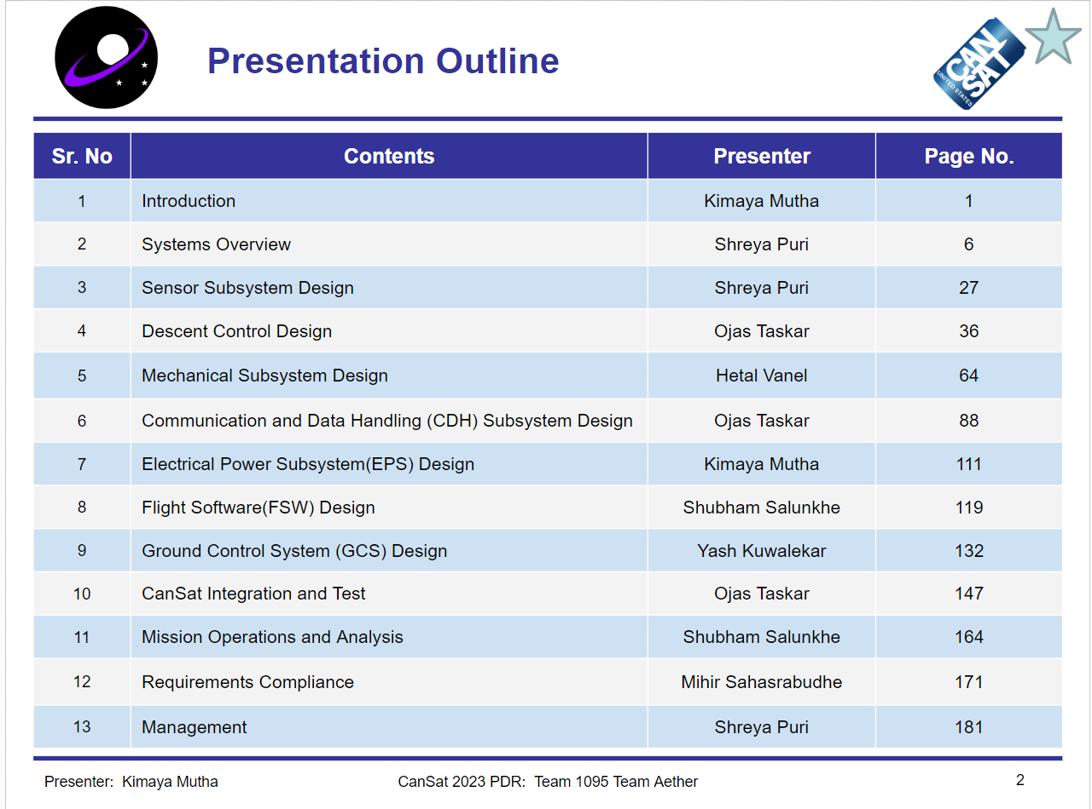
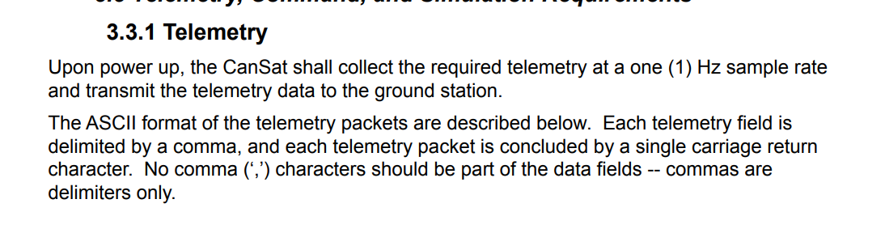
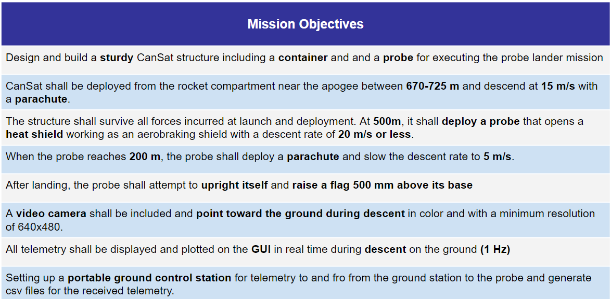
What is telemetry?

Slide 2
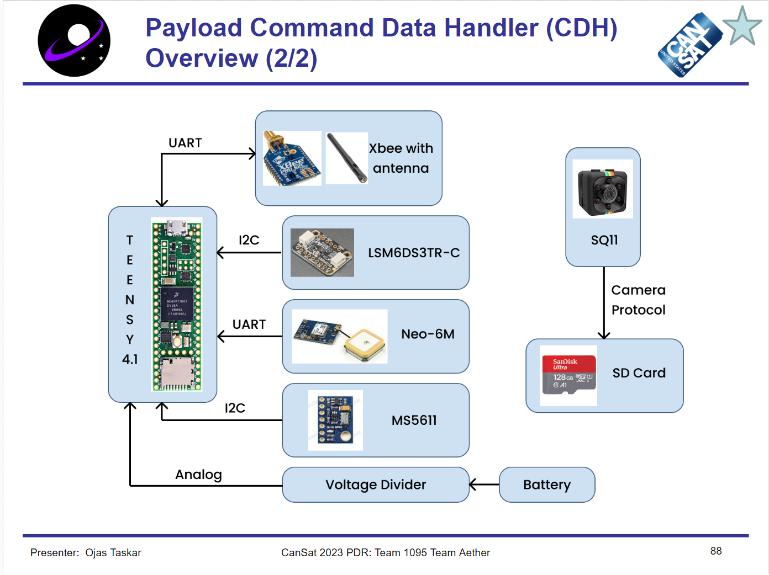
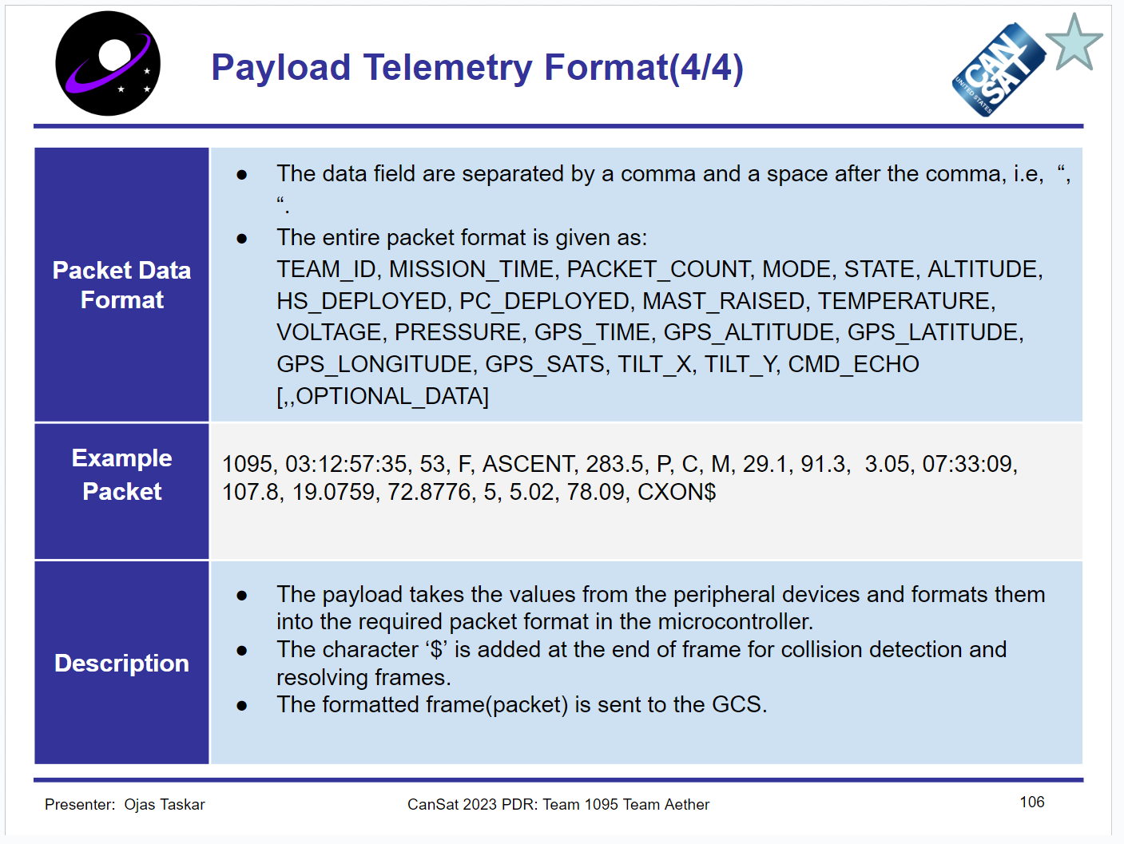
Section 1 - Payload - Packets

Slide 3
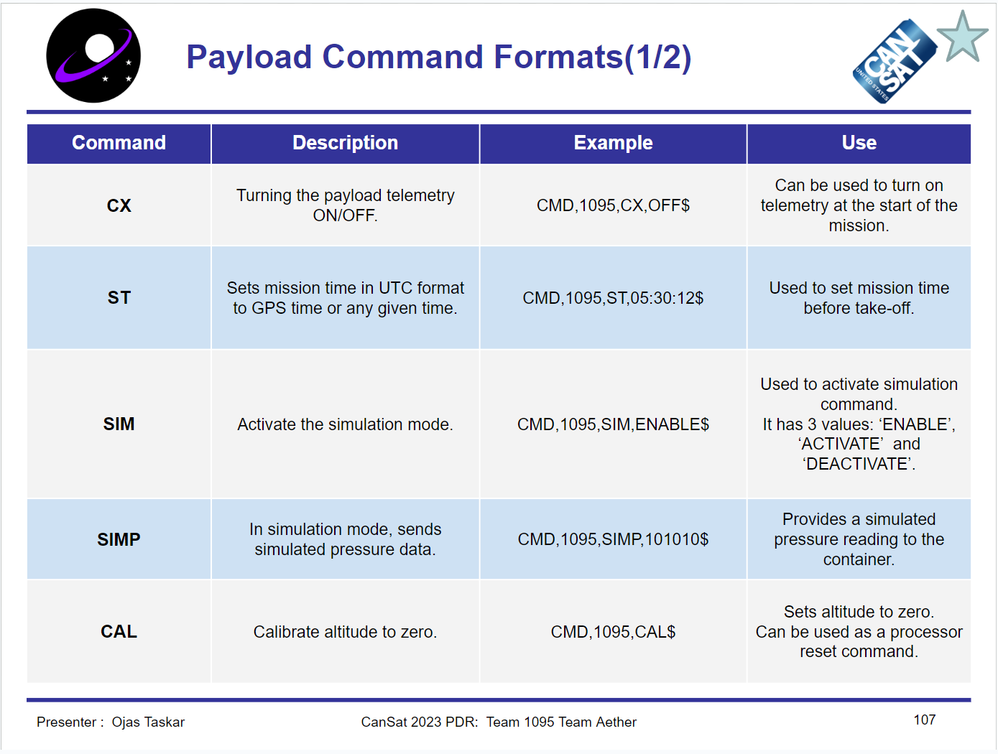
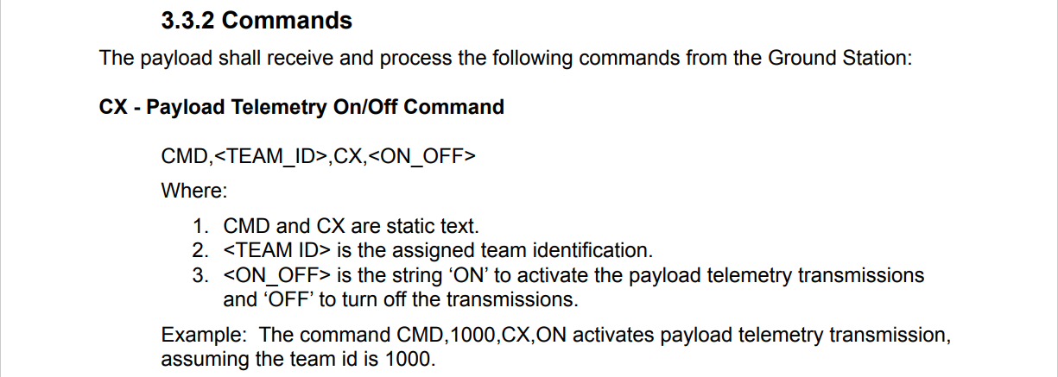
Section 2 - Payload - Commands

Slide 4
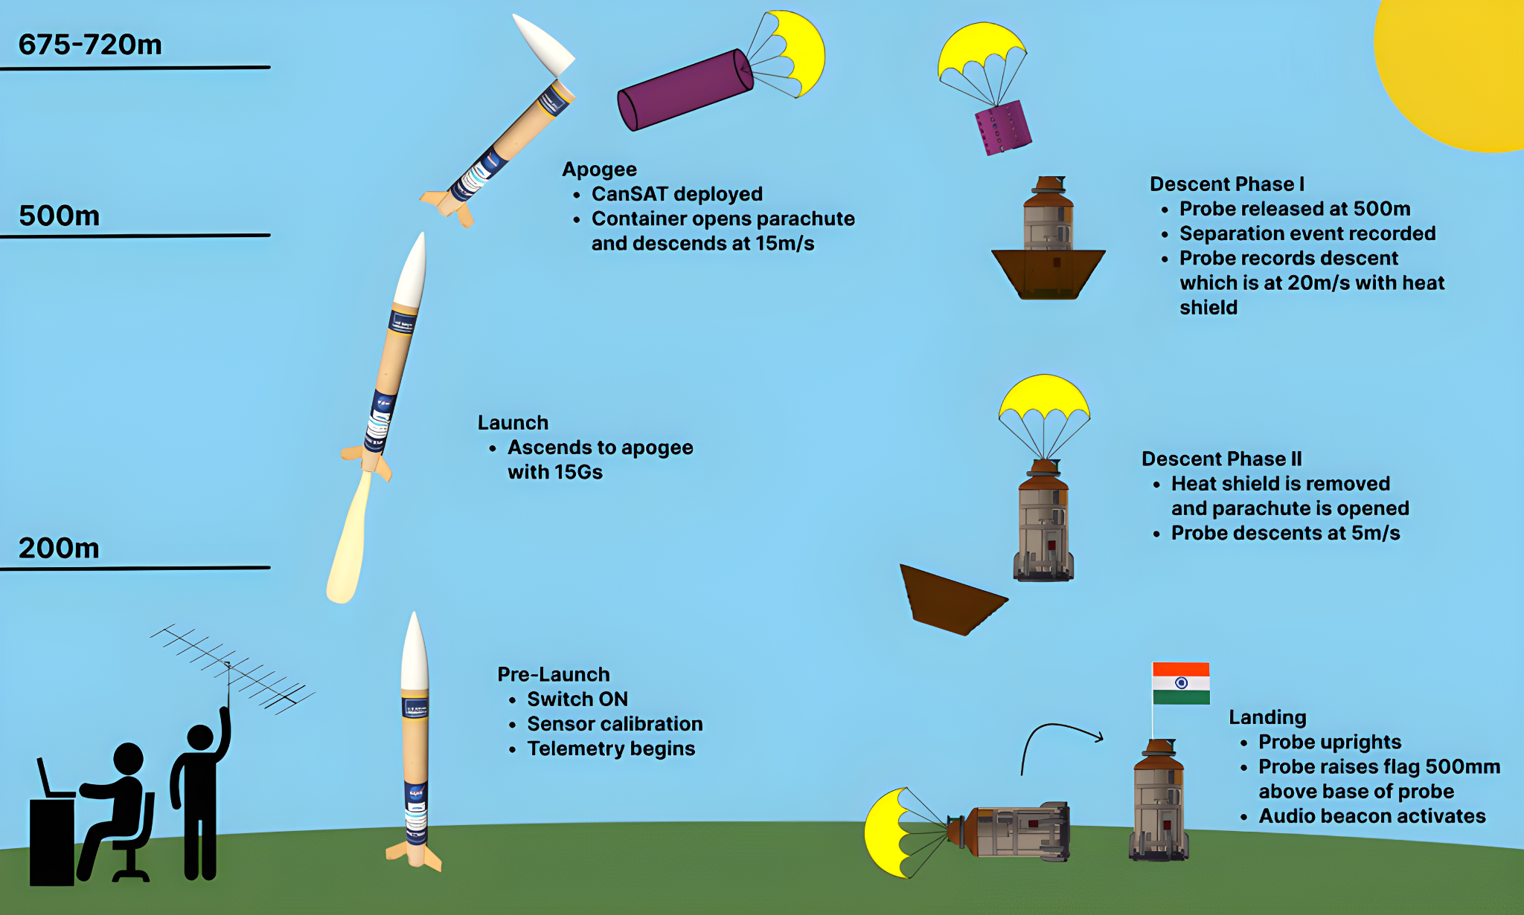
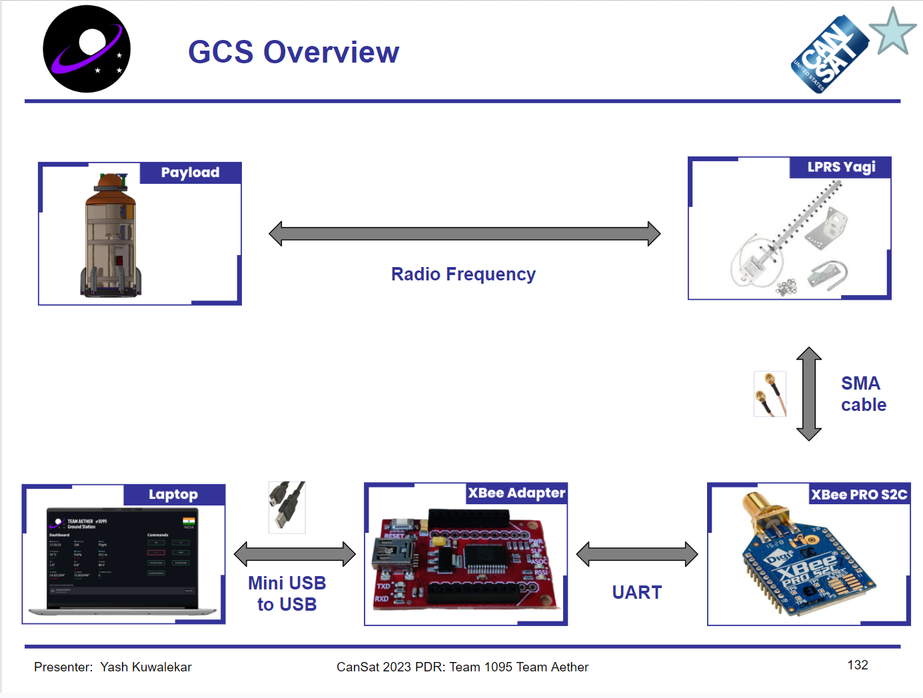
Ground Control - 1

Slide 5
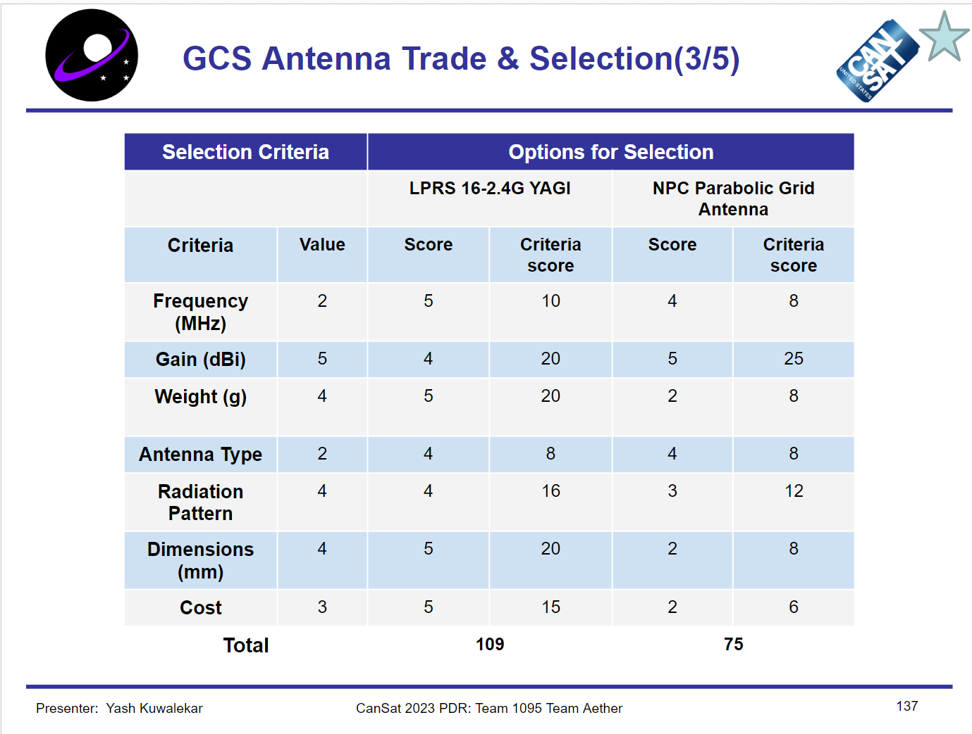
Ground Control - 2
The major issues are with testing the GCS antenna, debugging in case our comms don’t work and mitigation of risk (failsafes)
This part is the only one yet to be finished under CanSat telemetry.

Slide 6
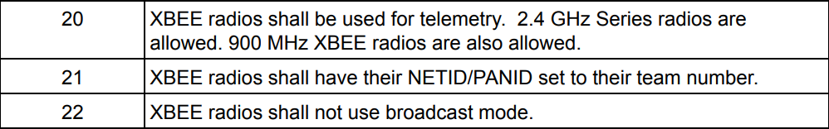
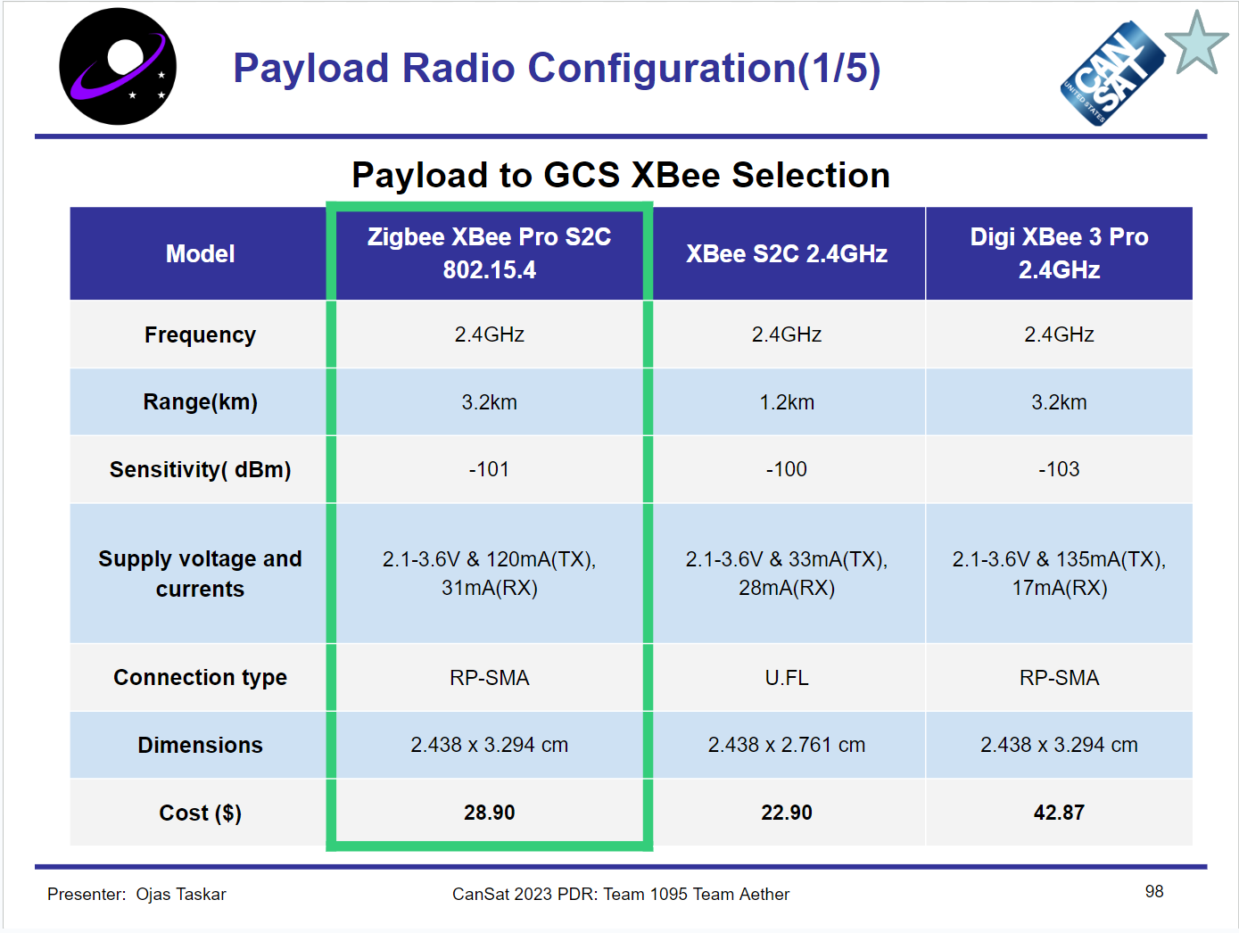
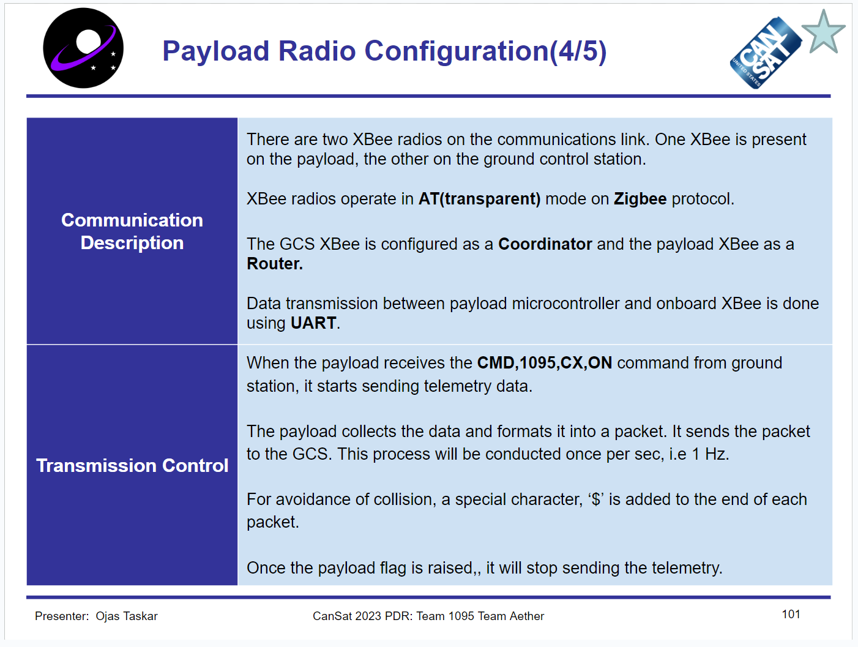
XBee!

Slide 7
Next tasks
Entire PDR template section analysis. Detailed notes of each and every point that is required by the judges.
PDR template flow and approx difficulty level ranking (will explain this)
Prev. year mission statement thorough reading. To ensure this is done well, we’ll do this in a timed manner.
Hopefully, a small quiz kinda thing to see if you’ve actually understood what needed to be understood.

